Slide 1

COURSE : OBJECT ORIENTED PROGRAMMING LANGUAGE
COURSE COORDINATOR : N.VENKATA RAMANA SIR
TITLE OF THE PROJECT : RESERVATION MANAGEMENT SYSTEM
LIST OF DEVELOPERS : A.SOMINI
C.LOUKYA
A.HARSHA VARDHINI
K.VARSHA
I.VYSHNAVI

Slide 2

BRIEF ON PROJECT
Reservation Management System using Java.
In this system allows you to make reservations for guests in online mode.
Online reservation systems have become increasingly popular in recent years, as more and more businesses look to streamline their booking process and provide a more convenient experience for their customers.
In this blog, we will discuss how to build an online reservation system using Java.
The online reservation system we will build will be a simple console-based application that allows users to make, view, and cancel reservations.
For businesses, online reservation systems offer a number of benefits, including increased efficiency, reduced workload, improved customer experience, and the ability to manage and monitor reservations in real-time.

Slide 3
FEATURES OF PROJECT:
In this project we are going to maintain a small RESERVATION MANAGEMENT RECORD by using java language.
In this we can allow users to make reservations for available resources, modify or cancel their reservations , confirmation or payment processing and Sends automated notifications and remainders to users about their reservations .
It Provides support for multiple languages and currencies to cater to diverse user requirements .
Allows administrators to manage resources or services, such as
Adding,
Updating or
Deleting resources,
Setting availability and
Managing pricing.
It may include features such as email notifications, SMS alerts, and in-app notifications.

Slide 4

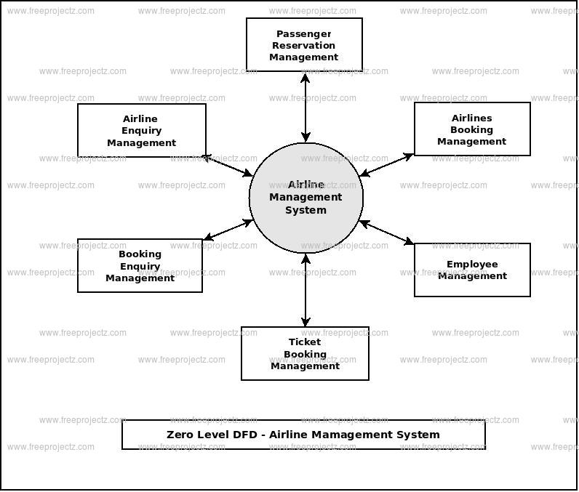

Slide 5

LIST OF CLASSES USED IN THIS PROJECT:
Reservation
Reservation Manager
Reservation Management System
LIST OF METHODS USED IN THIS PROJECT:
get ReservationId()
get PassengerName()
get FlightNumber()
get SeatNumber()
Confirm Reservation()
Cancel Reservation()
Reservation Manager()
Add reservation()

Slide 6

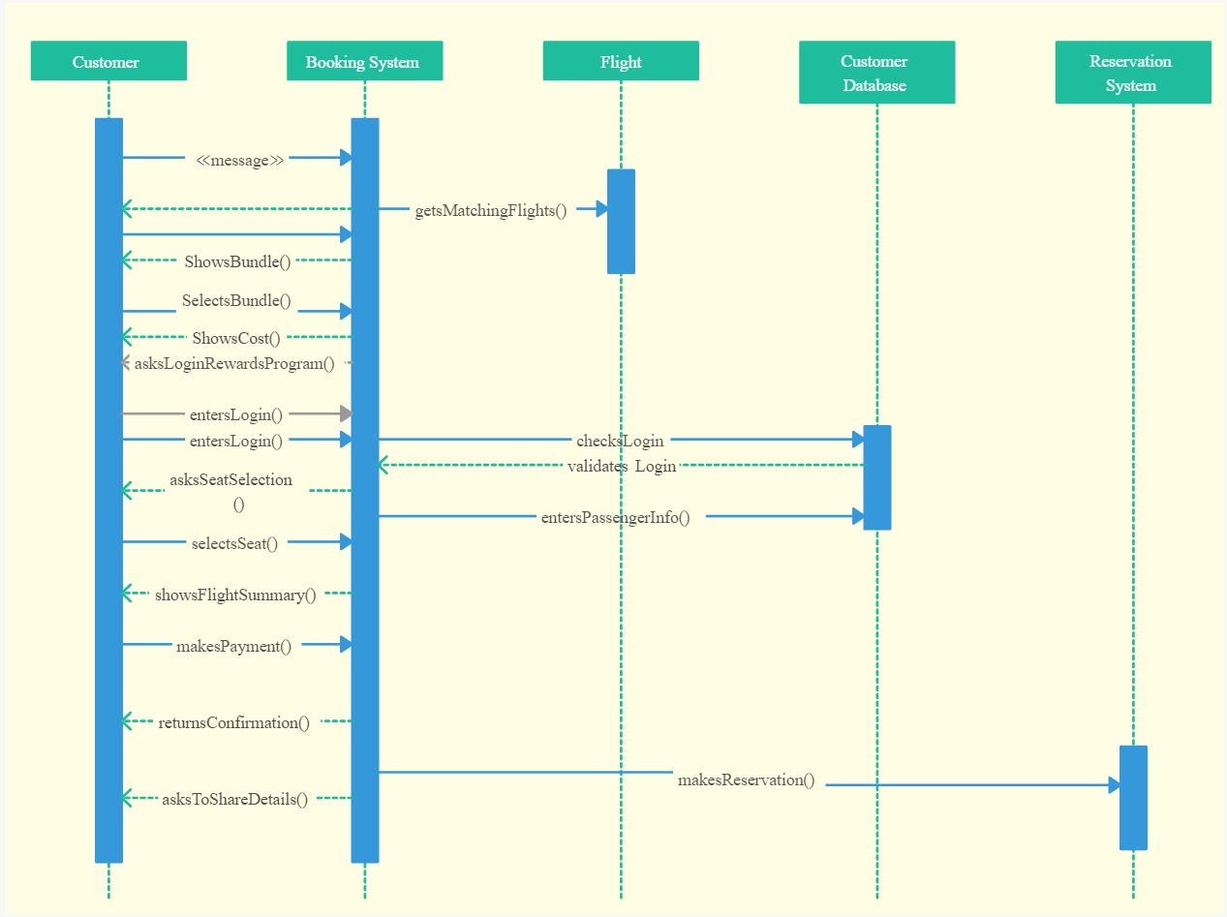

Slide 7
INTERFACES OF JAVA ON RESERVATION MANAGEMENT SYSTEM:
Airline reservation System is a computerized system used to store and retrieve information and conduct transactions related to air travel.
The project is aimed at exposing the relevance and importance of Airline Reservation Systems.
It is projected towardsenhancing the relationship between customers and airline agencies through the use of ARSs, and thereby making it convenient for the customers to book the flights as when they require such that they can utilize this software to make reservations.
This software has two parts.
First is user part and the administrator part.
User part is used as a front end and administrator is the back end.
Administrator is used by airline authority.
It will allow the customers to access database and allow new customers to sign up for online access.
The system allows the airline passenger to search for flights that are available between the two travel cities, namely the “Departure city” and “Arrival city” for a particular departure and arrival dates.
The system displays all the flight’s details such as flight no, name, price and duration of journey etc.After search the system display list of available flights and allows customer to choose a particular flight.
Then the system checks for the availability of seats on the flight.
If the seats are available then the system allows the passenger to book a seat.
Otherwise it asks the user to choose another flight.

Slide 8
ROLES AND RESPONSIBILITIES
A.Somini :
Guiding the team members
Determine what needs to get done
Meet to discuss priorities on an ongoing basis
Understand your team’s strengths
C.Loukya:
selecting the information they need to solve problems or complete tasks.
break down tasks into steps and put information in order,
Find approach to the problem from another direction.
A.Harsha Vardhini:
Deal well with distractions focused .
Find information and are proactive about doing so.
Task oriented and ask for advice or input when they are stuck on problem.

Slide 9
K.Varsha:
work well with other people and listen to their suggestions.
like to check that they have understood problems, and suggest different ways of solving them in a team.
They can follow instructions to get tasks done and see how these contribute to overall team goals.
I.Vyshnavi
The planner plans the time commitments of the team and makes sure it is aligned with the needs of customers.
advises the team of upcoming plans and any anticipated changes.
monitors team productivity.
This includes summaries of work delivered, and reports .

Slide 10
QUESTION AND ANSWERS:
What is a Reservation Management System?
It is a cloud-based tool to help you manage your property’s operations and bookings to securely collect and store your details.
Serving as a centralized management system, a reservation management system allows you to keep track of everything in one place.
You can manage your rates with the click of a button, improve guest satisfaction through automated communication, track profitability through detailed reporting, and more!
Why should we use a Reservation Management System?
Simply put, the right reservation system can save your money, and improve your guests’ experience.
Reservation systems aim to simplify your day-to-day operations so you can spend more time focusing on what really matters.
By implementing a robust reservation system, you can increase efficiency by automating a huge portion of daily operations and conveniently streamlining a number of processes, including the guest’s online booking journey.

Slide 11
What are the roles of reservation manager?
The reservation department handles all reservation requests for accommodation, interacts with the customers and constantly monitors the room status and the reservation status. The role of reservation department is not limited to making reservation.
What do you conclude from this project?
It reduces the scope of manual error and conveniently maintains any modifications, cancellations in the reservations. It not only provides flight details but also but also creates a platform to book tickets, cancels or modifies ticket timings or dates and even informs about the number of people on board

Slide 12


